Slide 1

SQL Management Studio
Indexing Metadata Extractions
Examples on: Adventure Works Database
Version 1.0
Shrikesh Pattni

Slide 2
How we should think of Master Metadata Management
Data Warehouse
Volume: SQL Tables, Dev/Test/Production
Volume: 3,000 + data assets in enterprise heavy data projects
Velocity: Data is updated daily/weekly with increments
Variety: Increase in complexity of relationships/data types
Veracity: Daily backups/Version control enables quality
Value: Timestamp data attributes,
Metadata/Governance
Value: Removing confusion by understanding data definitions
Value: Better levels of completeness/accuracy/row count of data
Value: Removing assumptions and guess work on data structure
Value: Better levels of performance optimisations on data assets
Value: Increase confidence to technical/non technical stakeholders
Value : *All above resulting In better communication channels*
Data Warehouse
Data Taxonomy
Variety: Classification of data assets into valuable entities
Value: Data Dictionary enables better levels of insights
Veracity: Increase data trust to increase value and engagement
Veracity: Remove biased and falsification (integer value column)
Metadata/Governance
Value Creation
Value: Richer, tangible value around Data Analytics
Value: Team engagement, active as opposed to reactive culture
Value: Internal/External operational value add changes
Value: Performance Optimisations on data assets
Taxonomy
Value Creation

Slide 3

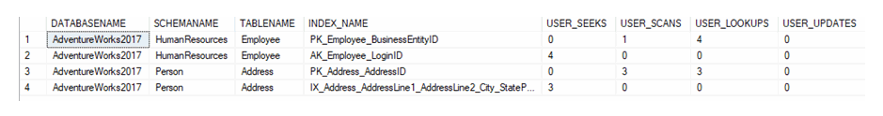
Get a list of the indexes that have been used and how they are being used based on 4 assessments
00
Shrikesh Pattni

Slide 4
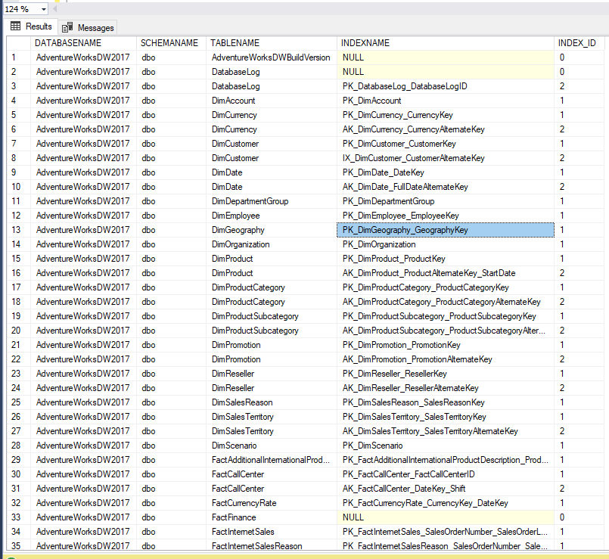
List all of the tables indexes that have not been used
01
Shrikesh Pattni

Slide 5
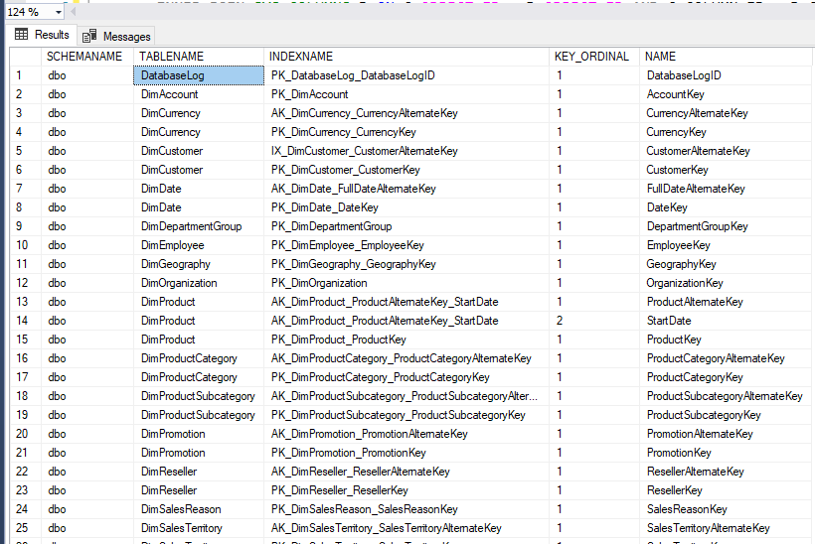
List each user table, all of its indexes and the columns that make up the index
02
Shrikesh Pattni

Slide 6
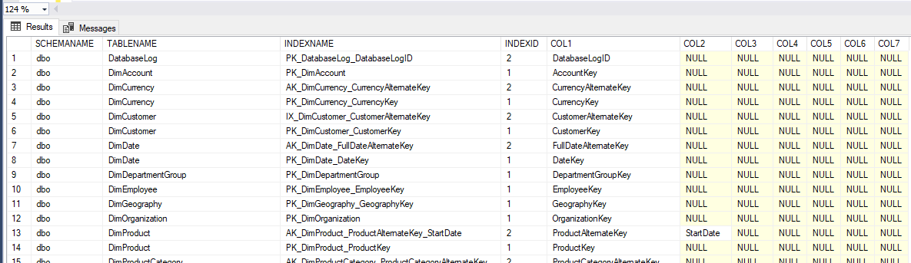
See the index and the index columns in one row
03
Shrikesh Pattni

Slide 7
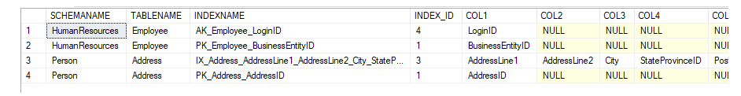
Look at only the indexes that have been used
04
Shrikesh Pattni

Slide 8
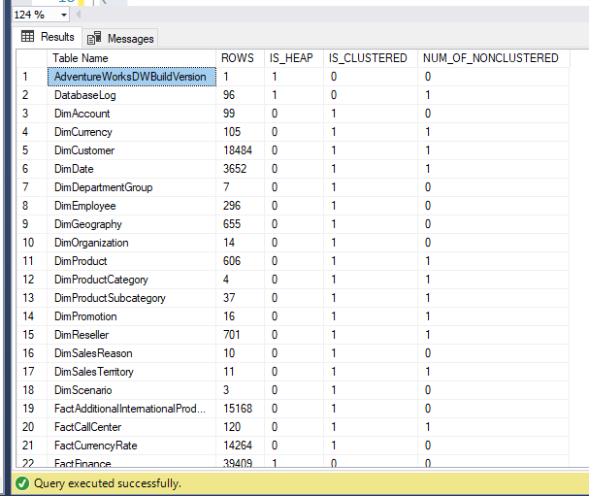
Find out all of the tables without indexes to understand Clustered and Non-Clustered Indexes
05
Shrikesh Pattni

Slide 9
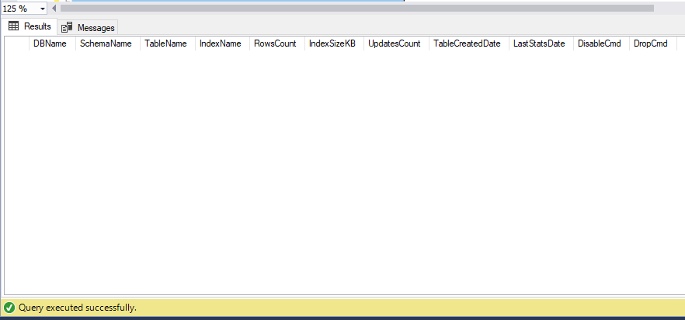
Extract all unused indexes across all of your databases and include a remediation script to be added
06
Shrikesh Pattni

Slide 10
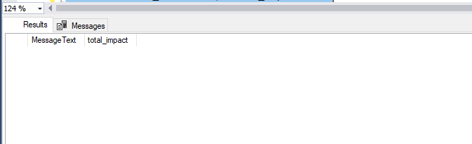
Extract and find out all missing indexes with the highest impact.
07
Shrikesh Pattni

Slide 11
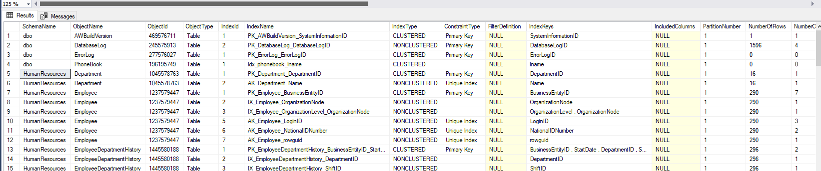
Extract all Clustered and Non-Clustered Indexed information on your database
08
Shrikesh Pattni

Slide 12
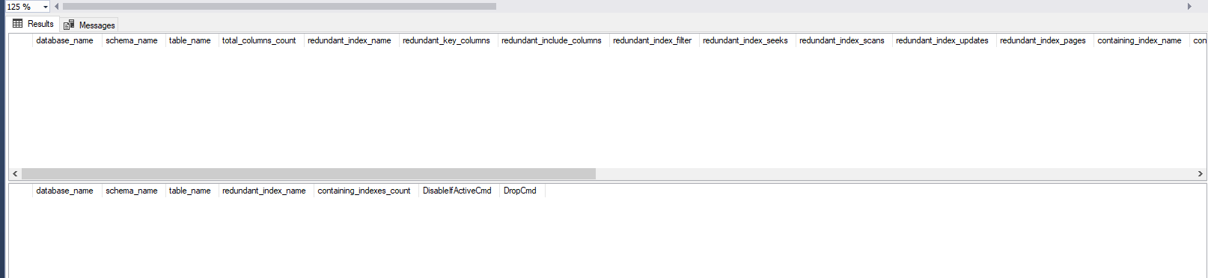
Extract and find out detailed information around redundant indexes on the selected database
09
Shrikesh Pattni

Slide 13
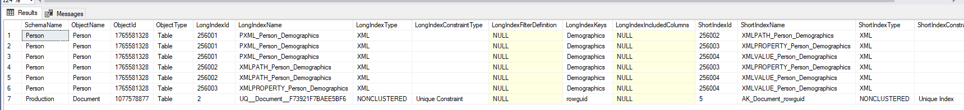
Extract and find out detailed information around redundant indexes on the selected database
10
Shrikesh Pattni

Slide 14
Extract and find out detailed information around redundant indexes on columns and get a remediation script.
11
Shrikesh Pattni

Slide 15
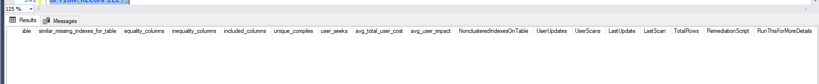
Missing Indexes and Detailed Recommendations
12
Shrikesh Pattni

Slide 16
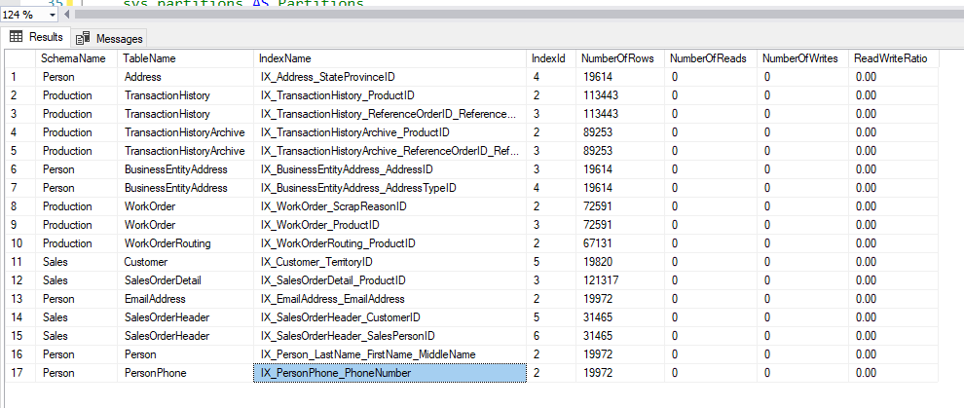
Get all the Indexes Reads and Writes Scan
13
Shrikesh Pattni

Slide 17
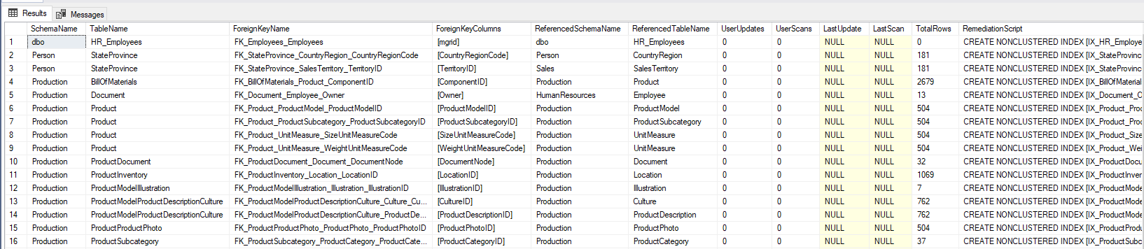
Get all Foreign Keys without corresponding indexes
14
Shrikesh Pattni

Slide 18
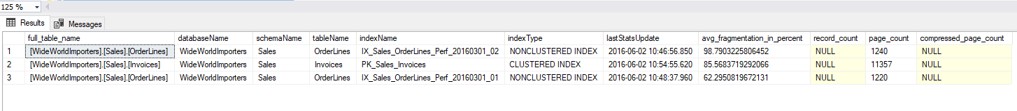
Extract and understand which tables have Index Fragmentation
15
Shrikesh Pattni

Slide 19
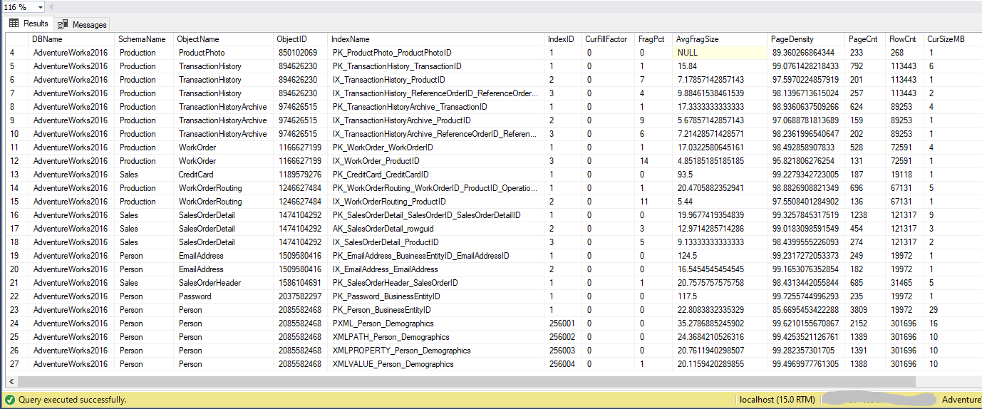
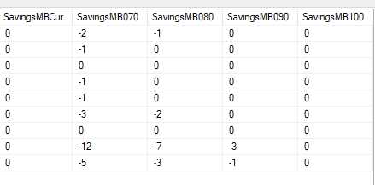
Understand accurately how much will it cost to build or save to build an index
16
Shrikesh Pattni

Slide 20
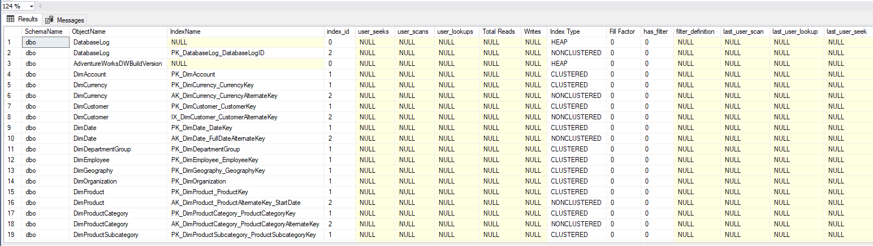
Extract and understand which tables have clustered & non-clustered indexes
17
Shrikesh Pattni

Slide 21
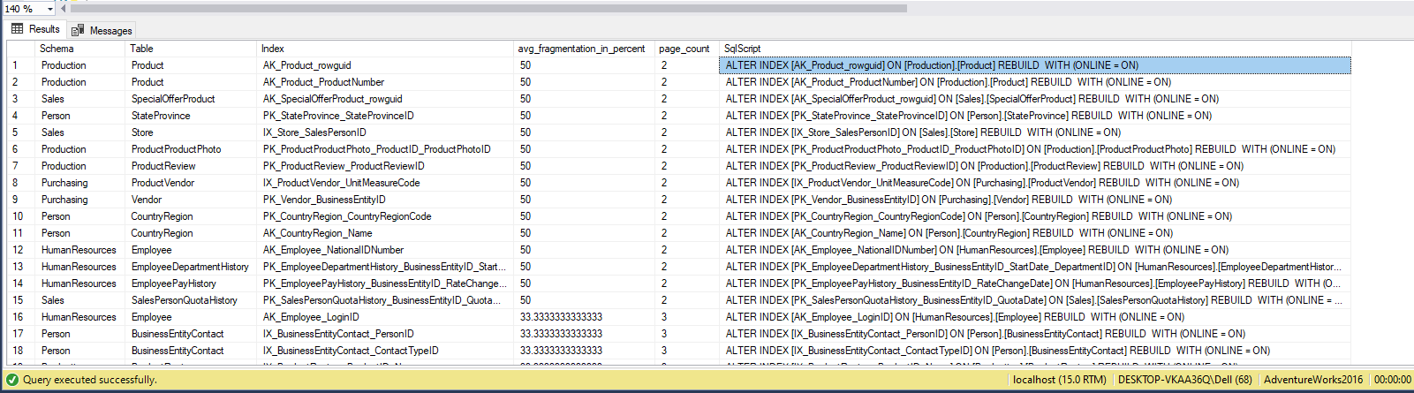
Check Index Fragmentation
18
Shrikesh Pattni

Slide 22
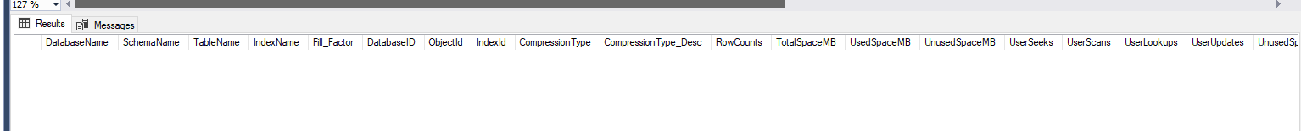
Check how much an index key has used/unused in a database
19
Shrikesh Pattni

Slide 23
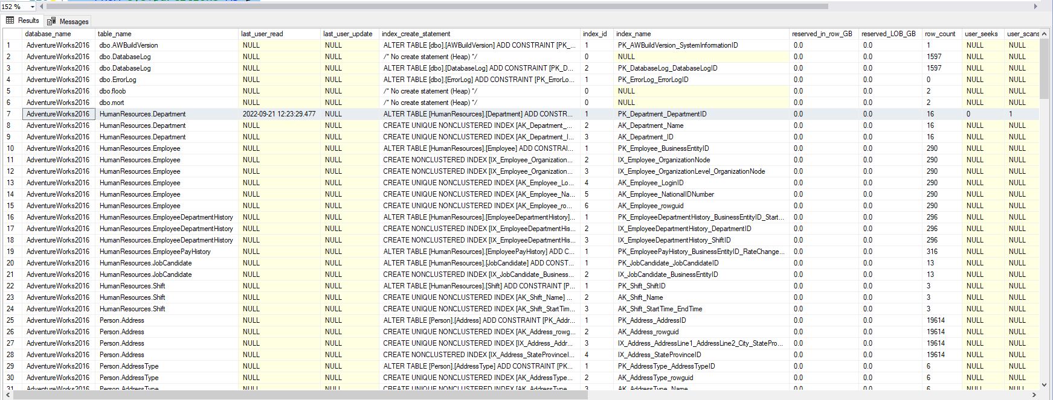
Retrieve all indexes a database has
20
Shrikesh Pattni

